Slide 1
Soar 9.5 Beta and
Explanation-Based Chunking

Slide 2
Previously on Soar Releases…
At the 2014 Soar Workshop, we announced three releases for the upcoming year:
  9.3.4 (June 2014), 9.4.0 (October 2014), 9.5.beta (now)
What’s new?
    Explanation-based chunking
    GQ-Lambda reinforcement learning policy
    Bug fixes and lots of more technical changes

Slide 3
Explanation-Based Chunking Motivation
Chunking’s utility was limited in many domains because it was very easy for agents to learn a large number of
overly-specific rules.
The problem occurs because chunking is not able to generalize knowledge involving numbers and strings.

Slide 4
A Chunk
sp {chunk*9.4.0
:chunk
(state <s1> ^operator <o1>)
(<o1> ^name fill)
(<o1> ^fill-jug <f1>)
(<f1> ^filled-jug yes)
(<f1> ^picked-up yes)
(<f1> ^volume 5)
(<f1> ^contents 3)
-->
(<f1> ^picked-up yes -)
(<f1> ^filled-jug yes -)
(<f1> ^contents 5 +)
(<f1> ^contents 3 -)}

Slide 5
Very Specific
sp {chunk*9.4.0
:chunk
(state <s1> ^operator <o1>)
(<o1> ^name fill)
(<o1> ^fill-jug <f1>)
(<f1> ^filled-jug yes)
(<f1> ^picked-up yes)
(<f1> ^volume 5)
(<f1> ^contents 3)
-->
(<f1> ^picked-up yes -)
(<f1> ^filled-jug yes -)
(<f1> ^contents 5 +)
(<f1> ^contents 3 -)}

Slide 6
Chunk Comparison
sp {chunk*9.4.0
:chunk
(state <s1> ^operator <o1>)
(<o1> ^name fill)
(<o1> ^fill-jug <f1>)
(<f1> ^filled-jug yes)
(<f1> ^picked-up yes)
(<f1> ^volume 5)
(<f1> ^contents 3)
-->
(<f1> ^picked-up yes -)
(<f1> ^filled-jug yes -)
(<f1> ^contents 5 +)
(<f1> ^contents 3 -)
(<f1> ^rhs 8 +)}
sp {chunk*9.5
:chunk
(state <s1> ^operator <o1>)
(<o1> ^name <c3>)
(<o1> ^fill-jug <i1>)
(<i1> ^filled-jug yes)
(<i1> ^picked-up yes)
(<i1> ^volume {> <c2> <c1>})
(<i1> ^contents <c2>)
-->
(<i1> ^picked-up yes -)
(<i1> ^filled-jug yes -)
(<i1> ^contents <c1> +)
(<i1> ^contents <c2> -)
(<f1> ^rhs (+ <c1> <c2>) +)}
Chunk learned in Soar 9.4.0
What we want

Slide 7
Chunk Comparison
sp {chunk*9.4.0
:chunk
(state <s1> ^operator <o1>)
(<o1> ^name fill)
(<o1> ^fill-jug <f1>)
(<f1> ^filled-jug yes)
(<f1> ^picked-up yes)
(<f1> ^volume 5)
(<f1> ^contents 3)
-->
(<f1> ^picked-up yes -)
(<f1> ^filled-jug yes -)
(<f1> ^contents 5 +)
(<f1> ^contents 3 -)
(<f1> ^rhs 8 +)}
sp {chunk*9.5
:chunk
(state <s1> ^operator <o1>)
(<o1> ^name <c3>)
(<o1> ^fill-jug <i1>)
(<i1> ^filled-jug yes)
(<i1> ^picked-up yes)
(<i1> ^volume {> <c2> <c1>})
(<i1> ^contents <c2>)
-->
(<i1> ^picked-up yes -)
(<i1> ^filled-jug yes -)
(<i1> ^contents <c1> +)
(<i1> ^contents <c2> -)
(<f1> ^rhs (+ <c1> <c2>) +)}
Chunk learned in Soar 9.4.0
What we want

Slide 8
How does EBC differ from chunking?
Chunking learned all its knowledge purely by analyzing the working memory trace.

Slide 9
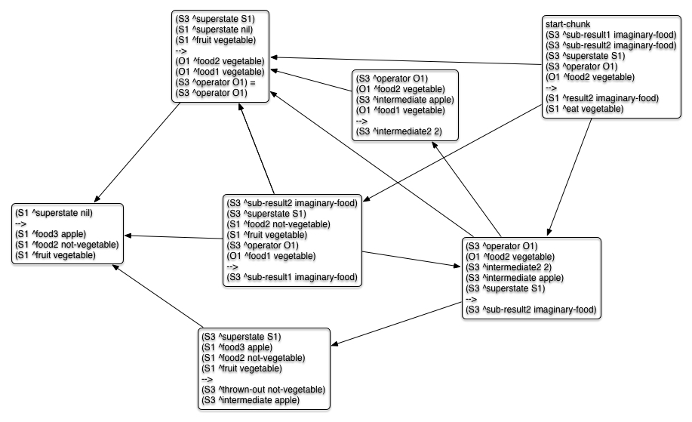

Slide 10
How does EBC differ from chunking?
EBC learns more general knowledge by also analyzing the explanation trace.
  Original human-written rules are superimposed over the WME trace to create the explanation trace.

Slide 11
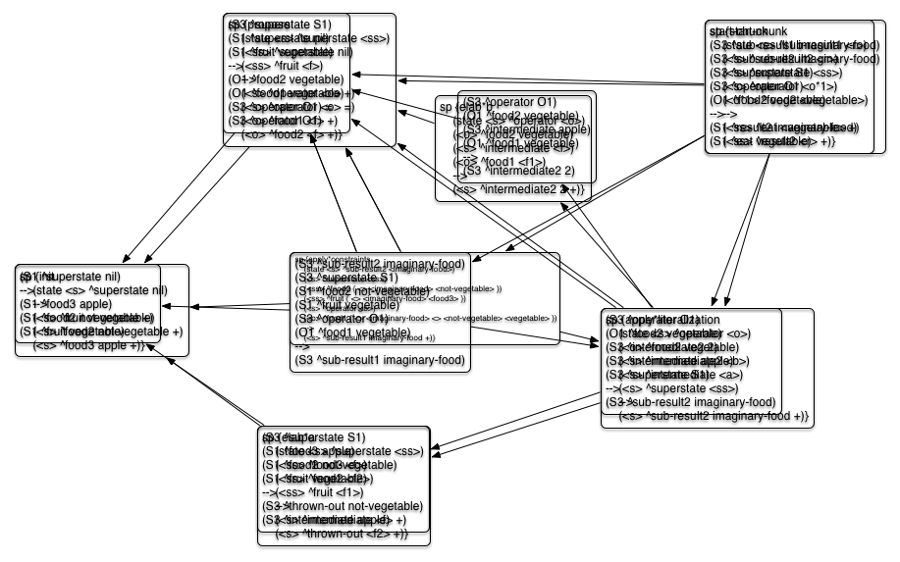

Slide 13
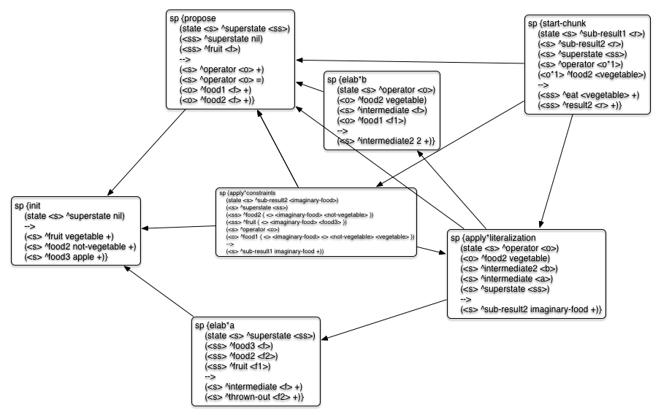

Slide 14
Why call it explanation-based?
  First, the rules explain the reasons why things matched and hence why they occurred in the problem-solving.
    The relationships between elements in different conditions
    What constraints on values had to be met

Slide 15
Why call it explanation-based?
  The rules also explain how relationships and constraints in one rule affect affect relationships and constraints in other rules
    Via the connection between a right-hand side action in one rule to the working memory element it created to a condition in another rule that later matched the working memory element.

Slide 16
How Does EBC Work?
EBC analyzes the explanation trace to build four sets of mappings that are needed to achieve these types of chunks
  Identity sets
  Identity unification sets
  A constraint set
  A literalization set

Slide 17
1. Identity
  A set of variablizable elements in an instantiation that must have the same value
    They had the same variable in the original rule
    EBC assigns an instantiation-specific id for each element in an identity set

Slide 18
  2. Identity unification sets
  A set of identity sets in a trace that must have the same value
  EBC builds a mapping from identities to identity sets while Soar backtraces through the working memory trace.
    Uses propagation rules talk won’t cover.

Slide 19
3. Identity Literalization Set
A set of identities in a trace that must have some literal value
  Technically, a very large set in most agents, because most attributes in rules are literals
  EBC handles this efficiently by propagating a null identity unification set

Slide 20
4. The Constraint Set
The set of all constraints that needed to be met for the problem-solving to occur.
  These are constraints on identity unification sets

Slide 21
Soar 9.5 EBC Summary
Creates an explanation trace
Assigns identities to identity unification sets
  Using identity propagation rules
Builds up a constraint set
Attaches constraints
Variablizes elements in condition based on membership in identity unification sets
  Items in the null literalization set retain their match value
Cleans up chunk
  Removes ungrounded STIs and merges certain conditions

Slide 22
Nuggets
We got it to do everything we wanted it to do, and are excited about trying it on many of our agents.
Fixed all known bugs we’ve seen so far and few long-standing general bugs
Has been tested with complex game learning agents
Should not require changes to agents
Notes:
One possible re-design issues: avoiding duplicate chunk creation when multiple results in the same decision cycle will all create the same chunk.
You still need to be careful about rules that test that test knowledge local to the substate. Those can still produce overgeneral chunks.

Slide 23
Coals
Just started analyzing and improving performance, so there’s a hit right now.
  We’ve already improved it to the point where we’re at least in the ball park.
  Does affect performance when learning is off.
    Was expected and necessary
Finished last target feature and bug fixes this week.
  No documentation yet
  No command-line explanation mechanism

